Slide 1
CS3391 Object Oriented Programming
Dr.D.Sivaganesan, Professor,
PSGiTech / CSE

Slide 2
Access Specifier in Java
The access modifiers in java specifies accessibility (scope) of a data member, method, constructor or class.
There are 4 types of java access modifiers:
public
private
protected
default

Slide 3
Public Access Modifier
The public access modifier is accessible everywhere. It has the widest scope among all other modifiers.
Example:
class A
{
public intvalue = 10;
public void msg()
{
System.out.println("Hello“+value);
}
}
public class expub{
public static void main(String args[]){
A obj = new A();
obj.msg(); } }

Slide 4


Slide 5
Private Access Modifier
The private access modifier is accessible only within class. It can't be applied to data member, method, constructor.
It can't be applied on the class.
class A{
private int value=10;
private void msg() {
System.out.println("Hello java“+value);} }
public class expriv{
public static void main(String args[]){
A obj=new A();
System.out.println (obj.value); //Compile Time Error
obj.msg();//Compile Time Error
}
}

Slide 6


Slide 7
Protected Access Modifier
The protected access modifier is accessible within package and outside the package but through inheritance only.
The protected access modifier can be applied on the data member, method and constructor. It can't be applied on the class.
class A
{
protected int value = 10;
protected void msg()
{
System.out.println("Hello "+value);
}
}
class exprotect extends A
{
public static void main(String args[])
{
A obj = new A();
System.out.println("object vale "+obj.value);
obj.msg();
} }

Slide 8


Slide 9
Default Access Modifier
If you don't use any modifier, it is treated as default bydefault. The default modifier is accessible only within package.
class AA
{ int value = 10;
void msg()
{
System.out.println("Hello "+value);
}}
class exdefault
{
public static void main(String args[])
{ AA obj = new AA();
System.out.println("object vale "+obj.value); obj.msg(); } }

Slide 10
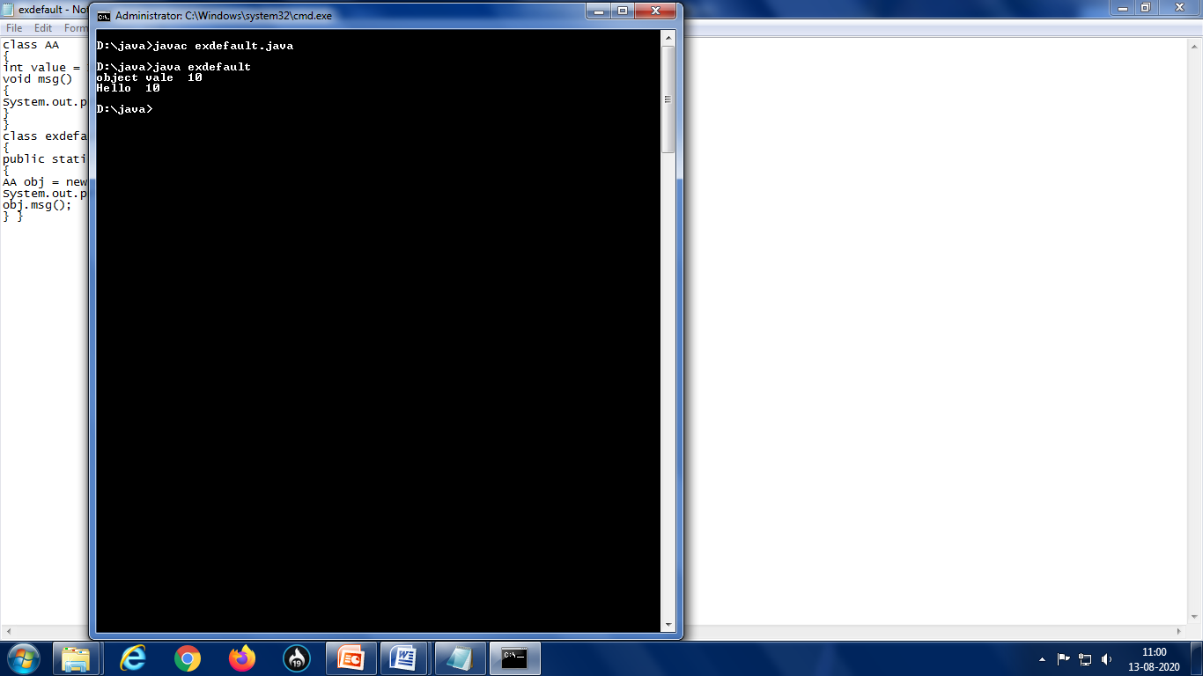

Slide 11
Access Modifier | Within Class | Within Package | Outside Package By Subclass Only | Outside Package
Private | Y | N | N | N
Default | Y | Y | N | N
Protected | Y | Y | Y | N
Public | Y | Y | Y | Y

Slide 12
Elements | public | private | protected | < unspecified >
class | allowed | not allowed | not allowed | allowed
constructor | allowed | allowed | allowed | allowed
variable | allowed | allowed | allowed | allowed
method | allowed | allowed | allowed | allowed

Slide 13
Thank you

